Slide 1
Feasibility and user-experience of virtual reality in neuropsychological assessment following stroke
Neuropsychological Rehabilitation 2020
中科院医学3区

Slide 2
Introduction
1. Performances on cognitive tests do not translate easily to daily life functioning, which results in a poor understanding of the difficulties patients encounter in daily life.
2. Virtual Reality (VR) offers a novel possibility to assess cognitive functioning in simulated environments resembling daily life.
3. Is VR feasible to use in stroke patients? How do stroke patients experience non immersive and immersive VR?

Slide 3
Method
Participants: patients and healthy controls.
(1) Inclusion criteria
(a) clinically diagnosed with stroke (confirmed by an MRI or CT scan).
(b) aged ≥ 18 years.
(c) physically and cognitively able to perform two VR-tasks.
(2) Exclusion criteria
(a) epilepsy (癫痫).
(b) severe visuo-spatial neglect.

Slide 4
Method
2. VR Apparatus
(1) Unity3D, CM (24-inch monitor) and HMD.
(2) Virtual supermarket: 50*30 virtual metres, 20000 products, 18 shelves, maximum
speed of 0.5 m/s (Xbox wired controller and HTC Vive controller).

Slide 5
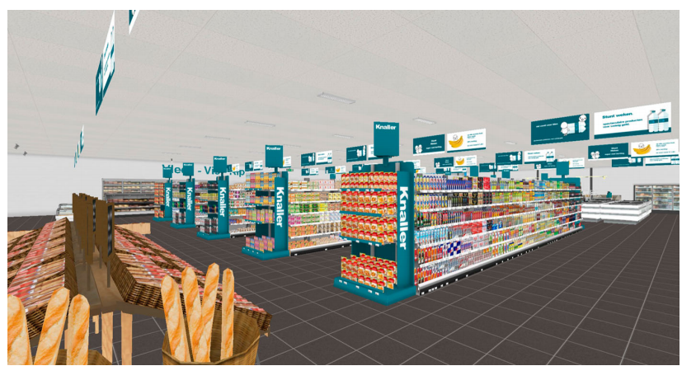

Slide 6
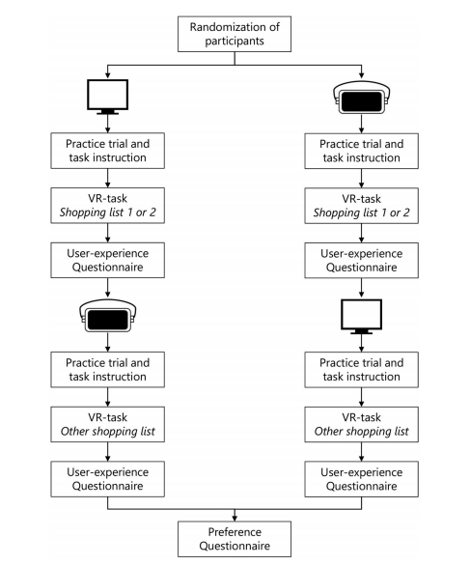
Method
3. Procedure

Slide 7
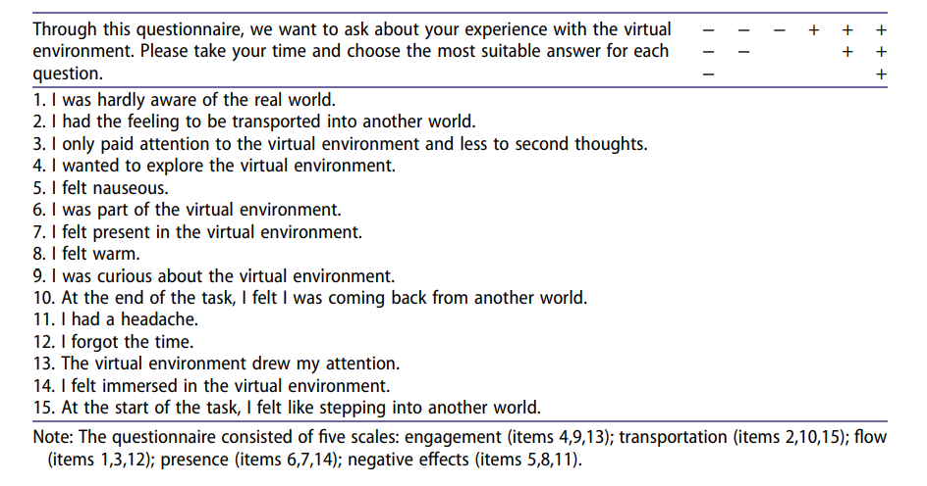
Method
4. User-experience questionnaire
(1) Engagement.
(2) Transportation.
(3) Flow.
(4) Presence.
(5) Negative effects.

Slide 8
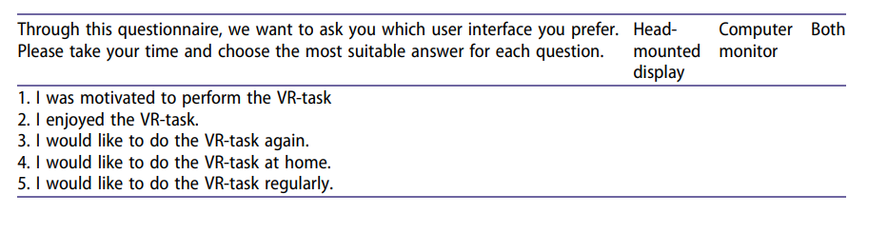
Method
5. Preference questionnaire

Slide 9
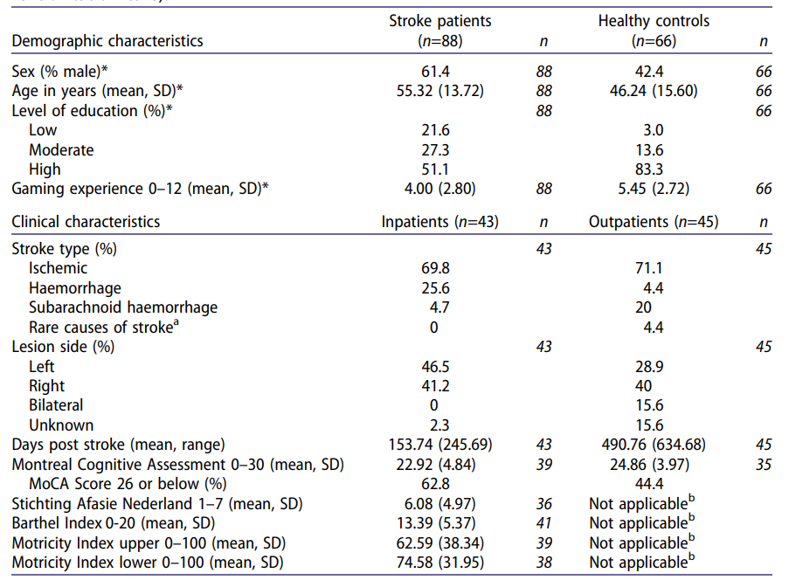
Results
1. Demographic and clinical characteristics

Slide 10
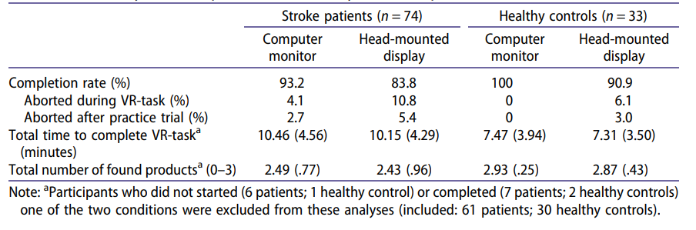
Results
2. Feasibility
(1) Stroke patients did not abort the VR-task more often than healthy controls with the CM nor with the HMD.
(2) Stroke patients did complete the VR-task more often with the CM than with the HMD.

Slide 11
Results
3. User-experience and preference
(1) Both patients and healthy controls reported an enhanced feeling of engagement, transportation, and presence, but more negative effects when tested with the HMD, compared to the CM.
(2) There was no significant difference in preference for one user interface over another between stroke patients and healthy controls with the majority reporting to have no preference.

Slide 12
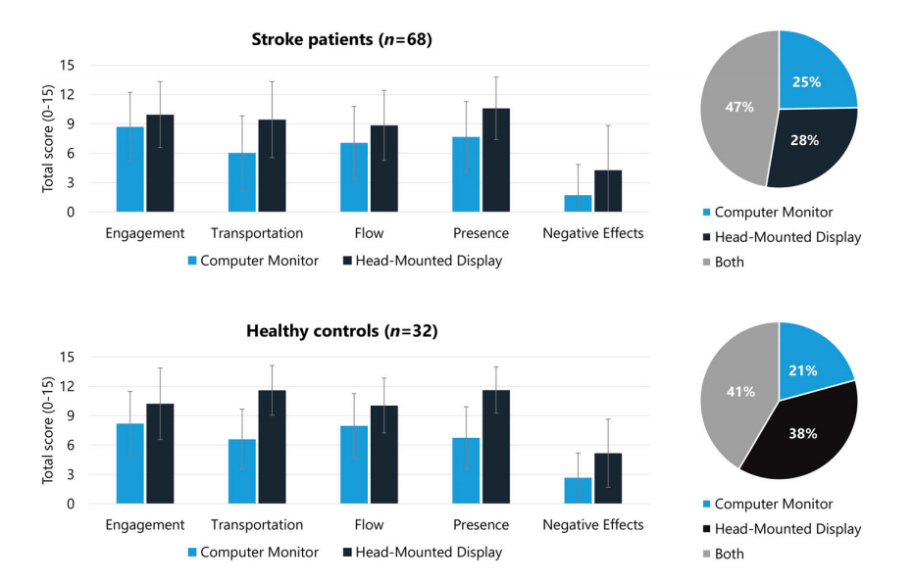

Slide 13
Results
4. Clinical effect
(1) Patients who were referred for inpatient rehabilitation care did not abort the VR task more often than patients who were referred for outpatient rehabilitation care with the CM nor with the HMD.
(2) Outpatients reported a significant improved feeling of engagement when conducting the VR-task with the HMD, compared to the CM.
(3) Age and preference for the HMD were negatively related among stroke patients.

Slide 14
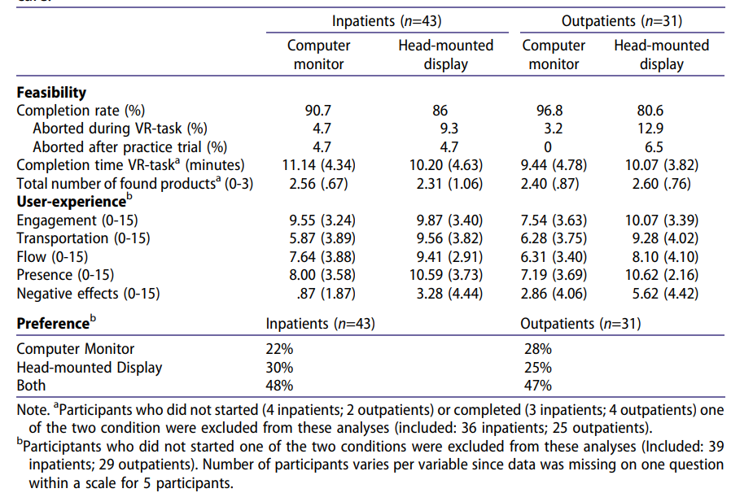

Slide 15
Discussion and Conclusion
1. The use of a HMD evokes an enhanced user-experience, which is expected to lead to a more natural behavior and interaction with the virtual environment.
2. More adverse physiological reactions were reported by both stroke patients and healthy controls when tested with a HMD, when compared to a CM.
3. Importantly, stroke patients reported no preference for one user interface (CM vs. HMD), which increases the usability of VR in clinical practice.
4. Limitations: feasibility of more severely hampered stroke patients; none/neither option.

